Slide 1
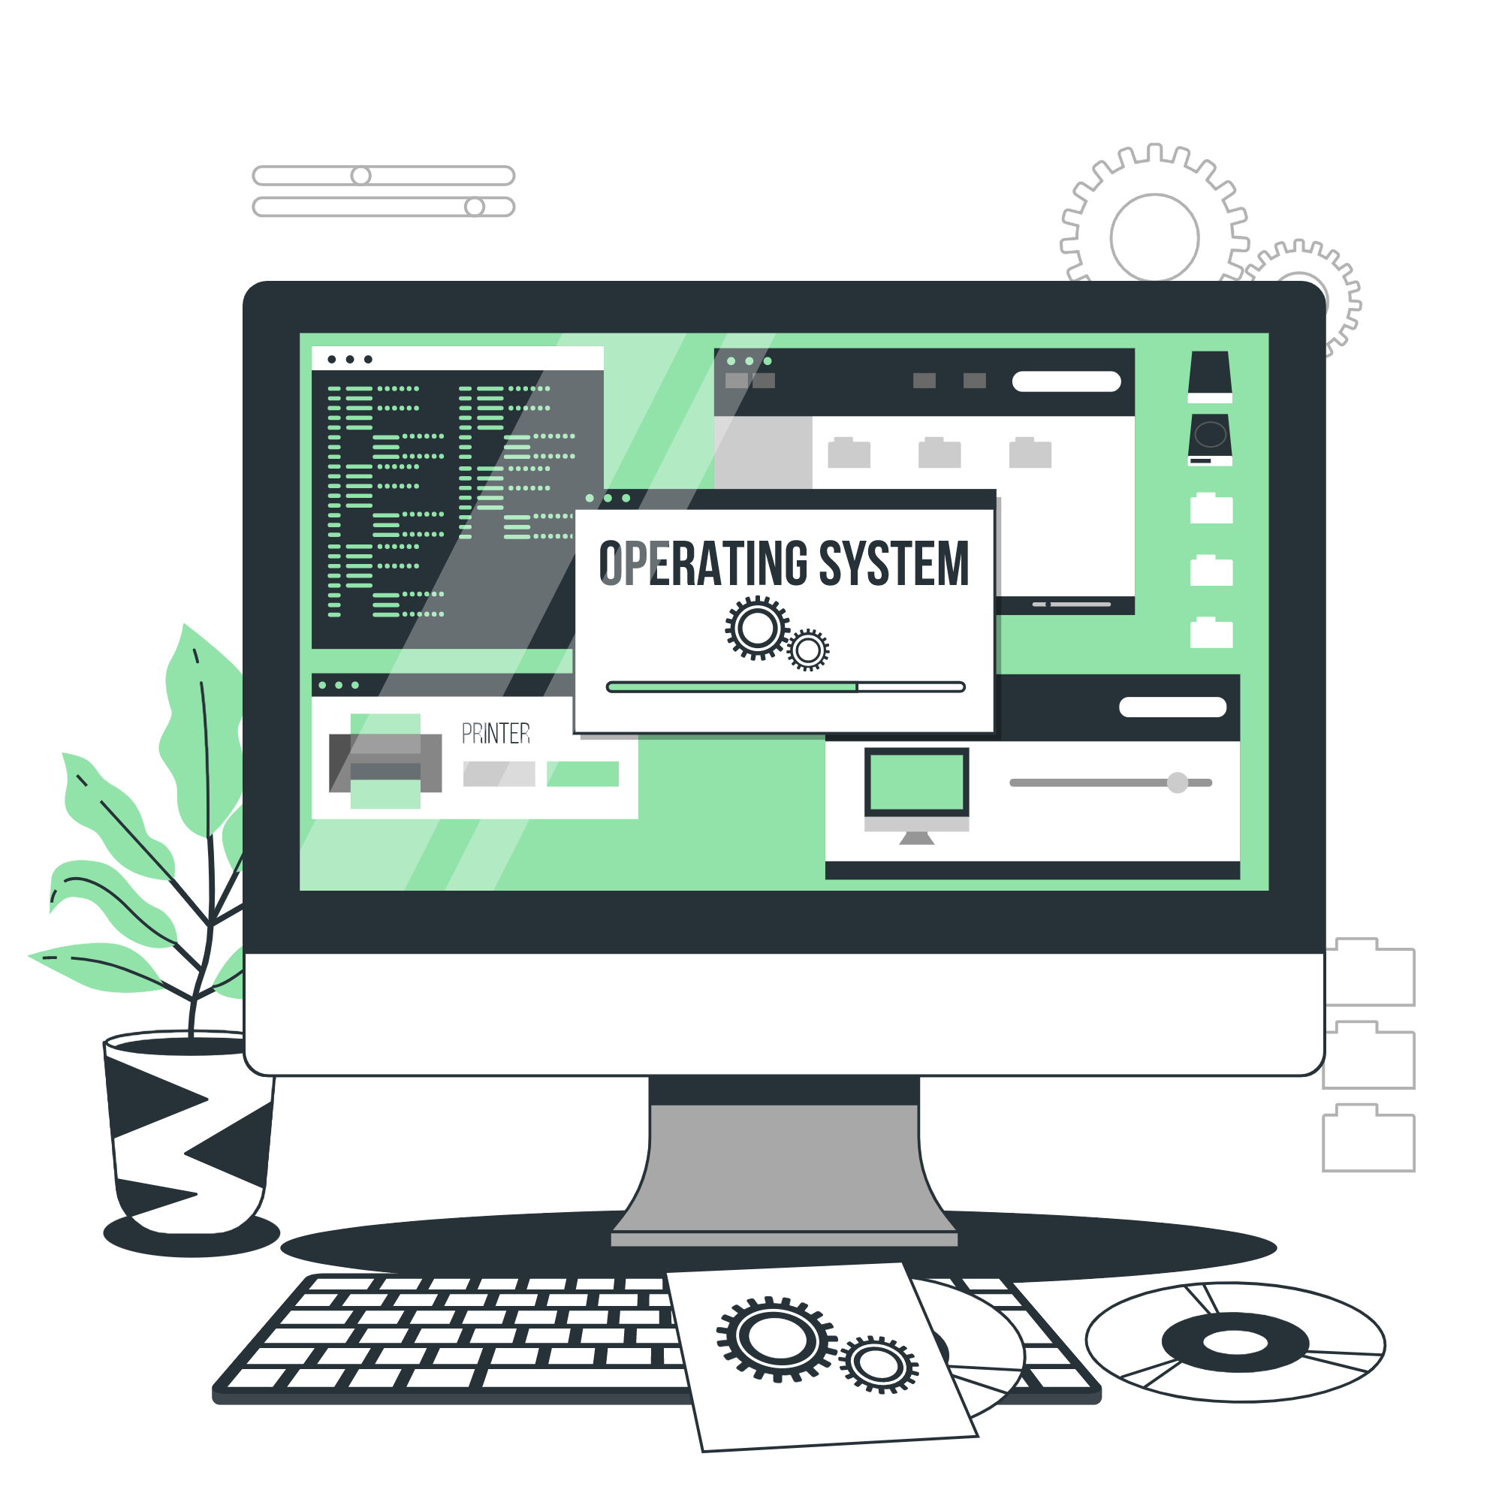
Operating System
Lecture: 4

Slide 2

Computer system Architecture, Special Purpose Processor, Computing Environment

Slide 3
Computer-System Architecture
Most systems use a single general-purpose processor
Most systems have special-purpose processors as well
Multiprocessors systems growing in use and importance
Also known as parallel systems, tightly-coupled systems
Advantages include:
Increased throughput
Economy of scale
Increased reliability – graceful degradation or fault tolerance

Slide 4
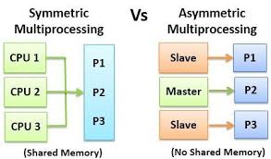
Computer-System Architecture
There are Two types of Computer-System Architecture
Asymmetric Multiprocessing – each processor is assigned a specie task.
Symmetric Multiprocessing – each processor performs all tasks

Slide 5
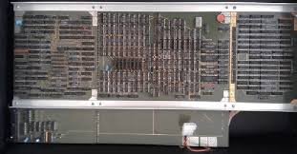
Special Purpose Processor
A special-purpose processor, also known as an application-specific processor, is designed to execute a specific set of tasks or functions efficiently. Unlike general-purpose processors (like those found in personal computers or smartphones), which are versatile and capable of running a wide range of software applications, special-purpose processors are optimized for a particular workload or application domain.

Slide 6
Special Purpose Processor
Here's a breakdown of what makes special-purpose processors unique:
Task-Specific Optimization: Special-purpose processors are engineered to excel in executing specific algorithms, tasks, or operations. This optimization often includes hardware and software tailored to the specific requirements of the application.
Efficiency: By focusing on a narrow set of tasks, special-purpose processors can achieve higher performance and efficiency compared to general-purpose processors. They can often perform tasks faster and with less power consumption.
Hardware Customization: These processors may integrate specialized hardware components, such as accelerators, dedicated caches, or custom instruction sets, to further enhance performance and efficiency for their targeted applications.

Slide 7
Special Purpose Processor
Here's a breakdown of what makes special-purpose processors unique:
Hardware Customization: These processors may integrate specialized hardware components, such as accelerators, dedicated caches, or custom instruction sets, to further enhance performance and efficiency for their targeted applications.

Slide 8
Special Purpose Processor
Special-purpose processors are commonly used in various domains:
Graphics Processing Units (GPUs): Optimized for parallel processing tasks in graphics rendering, AI, and scientific simulations.
Digital Signal Processors (DSPs): Designed for real-time signal processing tasks in telecommunications, audio processing, and image processing.
Network Processors: Tailored for handling networking protocols and packet processing in routers and switches.
Embedded Processors: Optimized for specific embedded systems applications like automotive control units, industrial automation, and consumer electronics.

Slide 9
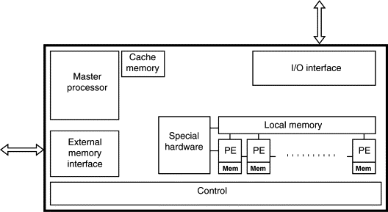
An Overview of Special Purpose Processor

Slide 10
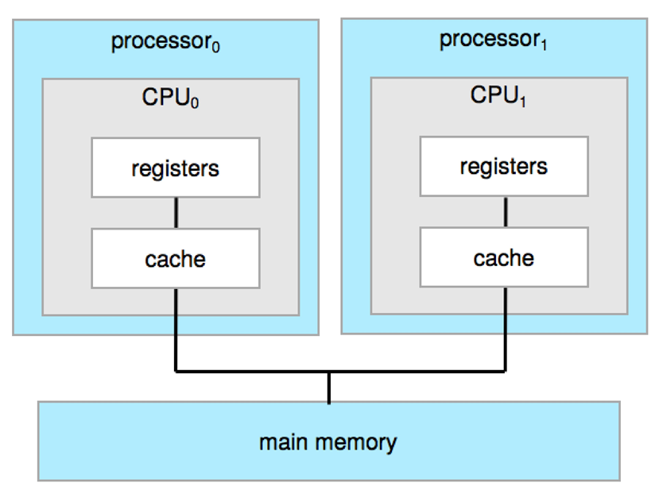
Symmetric Multiprocessing Architecture

Slide 11
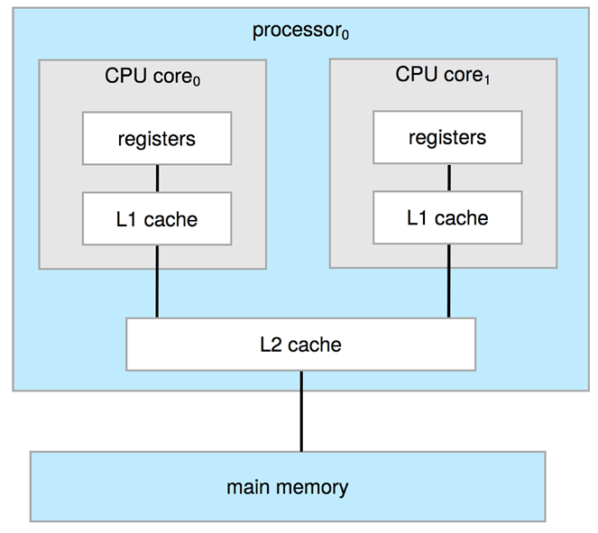
Dual-Core Design
Multi-chip and multicore
Systems containing all chips
Chassis containing multiple separate systems

Slide 12
Non-Uniform Memory Access System
Non-Uniform Memory Access (NUMA) is a computer architecture design used in multiprocessor systems where each processor has its own local memory but can access shared memory.
Here's a concise overview of NUMA systems:
Architecture: NUMA systems consist of multiple processors (or nodes), each connected to a portion of the system's memory. Each processor can access its local memory quickly (low latency), but accessing memory attached to another processor involves longer access times (higher latency).

Slide 13
Non-Uniform Memory Access System
Here's a concise overview of NUMA systems: (cont.)
2. Memory Access Characteristics: In NUMA systems, memory access times can vary depending on whether the memory being accessed is local to the processor or located on a different node. This non-uniformity in access times gives rise to the term Non-Uniform Memory Access.
3. Advantages: NUMA architecture allows for scalability in multiprocessor systems, as adding more processors and memory nodes can enhance system performance without necessarily increasing latency significantly for local memory access.

Slide 14
Non-Uniform Memory Access System
Applications:
Efficient handling of large databases with multiple concurrent queries.
Optimized for data-intensive operations and transaction processing.
Supports virtual machines (VMs) with dedicated memory access to enhance performance.
Enables efficient resource allocation and management across virtualized environments.
Parallel processing capabilities for scientific simulations and computations.
Handles large datasets and complex calculations with improved performance.
Supports high-throughput transaction processing in banking, finance, and e-commerce.

Slide 15
Non-Uniform Memory Access System
Challenges:
NUMA-aware Memory Allocation: Allocate memory closer to the processor (node) where it will be accessed most frequently to minimize latency.
Memory Placement Policies: Use policies to prefer local memory allocation and minimize remote accesses.
Load Balancing: Monitor and adjust workload distribution to evenly utilize processing power across NUMA nodes.
Cache Management: Use caching strategies to improve data locality and reduce memory access times.
Performance Monitoring: Continuously monitor NUMA node utilization and memory access patterns to identify bottlenecks and optimize performance.

Slide 16
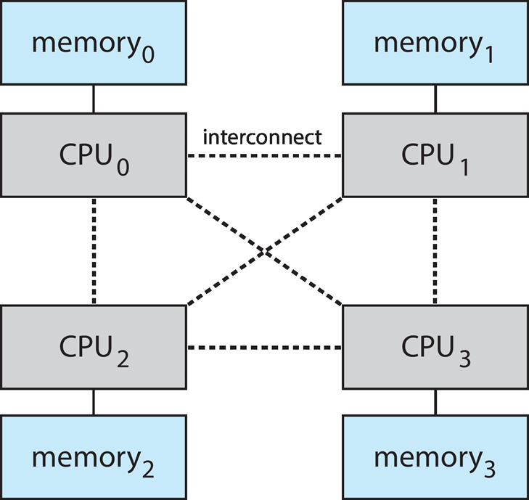
Non-Uniform Memory Access System

Slide 17
Clustered Systems
Like multiprocessor systems, but multiple systems working together
Usually sharing storage via a storage-area network (SAN)
Provides a high-availability service which survives failures
Asymmetric clustering has one machine in hot-standby mode
Symmetric clustering has multiple nodes running applications, monitoring each other
Some clusters are for high-performance computing (HPC)
Applications must be written to use parallelization
Some have distributed lock manager (DLM) to avoid conflicting operations

Slide 18
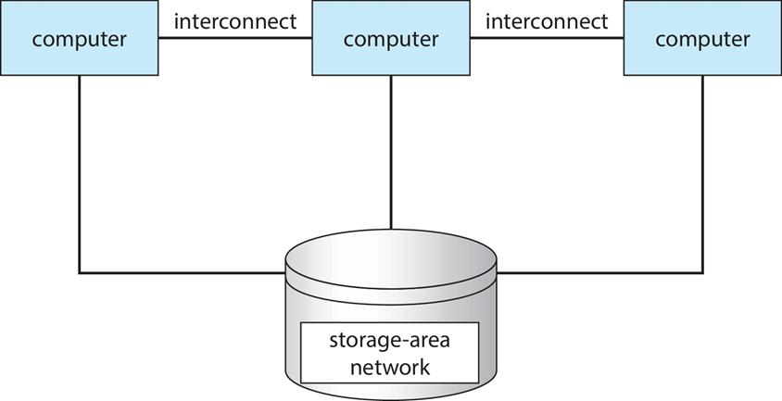
Clustered Systems

Slide 19
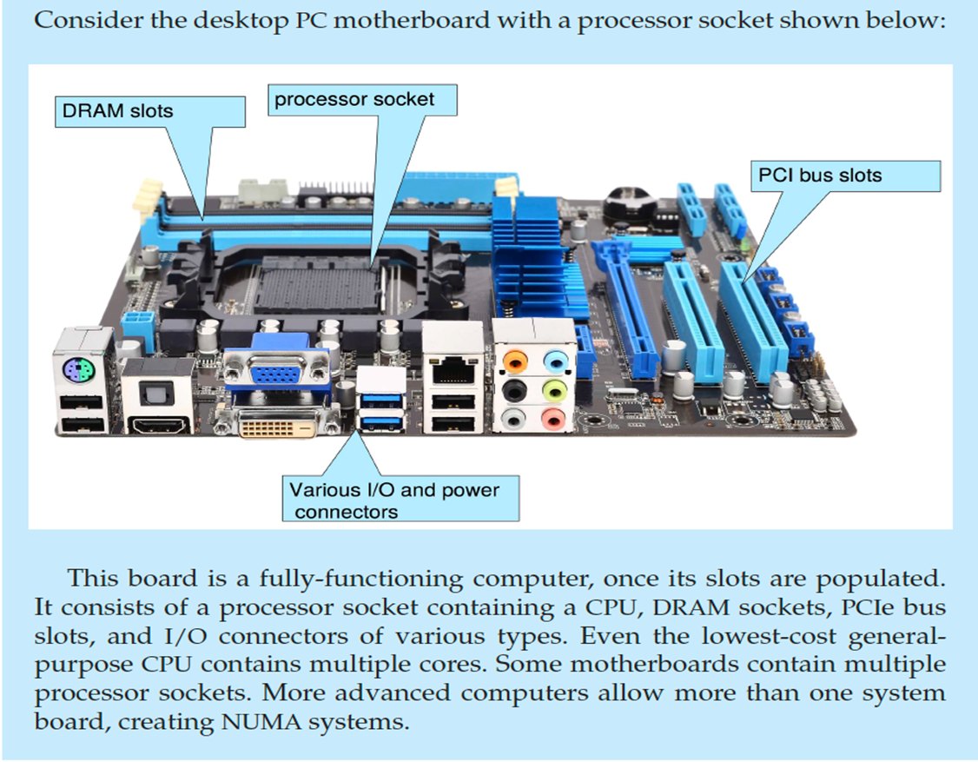
PC Motherboard

Slide 20
Computing Environments
Traditional
Mobile
Client Server
Peer-to-Peer
Cloud computing
Real-time Embedded

Slide 21
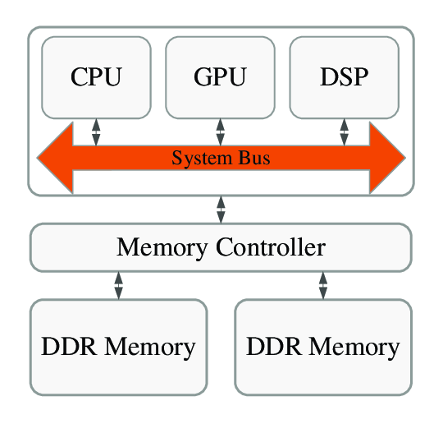
Traditional
Stand-alone general-purpose machines
But blurred as most systems interconnect with others (i.e., the Internet)
Portals provide web access to internal systems
Network computers (thin clients) are like Web terminals
Mobile computers interconnect via wireless networks
Networking becoming ubiquitous – even home systems use firewalls to protect home computers from Internet attacks

Slide 22
Applications of Traditional Computing
Mainframes for large-scale data processing
Legacy systems in banking and finance
Industrial control systems

Slide 23
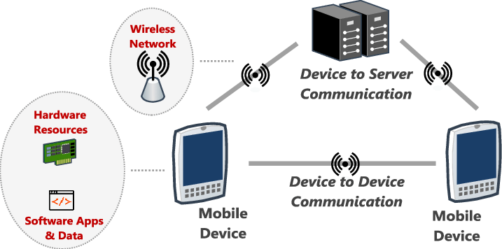
Mobile
Handheld smartphones, tablets, etc.
What is the functional difference between them and a “traditional” laptop?
Extra feature – more OS features (GPS, gyroscope)
Allows new types of apps like augmented reality
Use IEEE 802.11 wireless, or cellular data networks for connectivity
Leaders are Apple iOS and Google Android

Slide 24
Applications of Mobile Computing
Mobile apps for social networking (e.g., Facebook, Instagram)
Navigation apps (e.g., Google Maps, Waze)
Gaming (e.g., mobile games)
Productivity tools (e.g., Microsoft Office Mobile)
Health monitoring apps (e.g., fitness trackers)

Slide 25
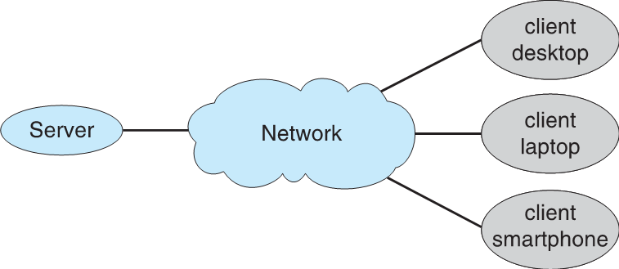
Client Server
Client-Server Computing
Dumb terminals supplanted by smart PCs
Many systems now servers, responding to requests generated by clients
Compute-server system provides an interface to client to request services (i.e., database)
File-server system provides interface for clients to store and retrieve files

Slide 26
Applications of Client-Server Computing
Email servers (e.g., Microsoft Exchange)
Database servers (e.g., Oracle Database)
Web servers (e.g., Apache, Nginx)
Enterprise resource planning (ERP) systems
Cloud computing platforms (e.g., AWS, Azure)

Slide 27
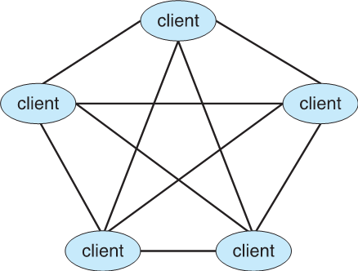
Peer-to-Peer
Another model of distributed system
P2P does not distinguish clients and servers
Instead all nodes are considered peers
May each act as client, server or both
Node must join P2P network
Registers its service with central lookup service on network, or
Broadcast request for service and respond to requests for service via discovery protocol
Examples include Napster and Gnutella, Voice over IP (VoIP) such as Skype

Slide 28
Applications of Peer-to-Peer Computing
File sharing networks (e.g., BitTorrent)
Distributed computing (e.g., blockchain networks)
Collaborative applications (e.g., decentralized communication apps)

Slide 29
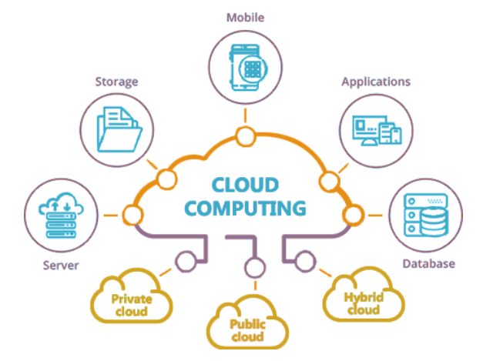
Cloud Computing
Delivers computing, storage, even apps as a service across a network
Logical extension of virtualization because it uses virtualization as the base for it functionality.
Amazon EC2 has thousands of servers, millions of virtual machines, petabytes of storage available across the Internet, pay based on usage

Slide 30
Cloud Computing
Many types
Public cloud – available via Internet to anyone willing to pay
Private cloud – run by a company for the company’s own use
Hybrid cloud – includes both public and private cloud components
Software as a Service (SaaS) – one or more applications available via the Internet (i.e., word processor)
Platform as a Service (PaaS) – software stack ready for application use via the Internet (i.e., a database server)
Infrastructure as a Service (IaaS) – servers or storage available over Internet (i.e., storage available for backup use)

Slide 31
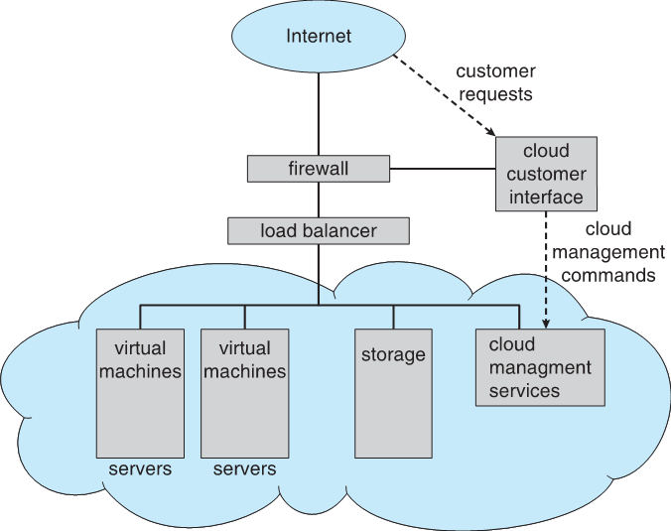
Cloud Computing
Cloud computing environments composed of traditional OSes, plus VMMs, plus cloud management tools
Internet connectivity requires security like firewalls
Load balancers spread traffic across multiple applications

Slide 32
Applications of Cloud Computing
Software-as-a-Service (SaaS) applications (e.g., Salesforce, Google Workspace)
Platform-as-a-Service (PaaS) for app development (e.g., Heroku)
Infrastructure-as-a-Service (IaaS) for scalable computing resources (e.g., AWS EC2)
Data storage and backup solutions (e.g., Dropbox, Google Drive)
Scalable web applications and websites

Slide 33
Real-Time Embedded Systems
Real-time embedded systems most prevalent form of computers
Vary considerable, special purpose, limited purpose OS, real-time OS
Use expanding
Many other special computing environments as well
Some have OSes, some perform tasks without an OS
Real-time OS has well-defined fixed time constraints
Processing must be done within constraint
Correct operation only if constraints met

Slide 34
Applications of Real-Time Embedded Computing
Automotive electronics (e.g., engine control units)
Consumer electronics (e.g., smart appliances)
Medical devices (e.g., patient monitoring systems)
Industrial automation (e.g., robotics)
Aerospace systems (e.g., flight control systems)

Slide 35
Free and Open-Source Operating Systems
Operating systems made available in source-code format rather than just binary closed-source and proprietary
Counter to the copy protection and Digital Rights Management (DRM) movement
Started by Free Software Foundation (FSF), which has “copyleft” GNU Public License (GPL)
Free software and open-source software are two different ideas championed by different groups of people
https://www.gnu.org/philosophy/open-source-misses-the-point.en.html
Examples include GNU/Linux and BSD UNIX (including core of Mac OS X), and many more
Can use VMM like VMware Player (Free on Windows), Virtualbox (open source and free on many platforms - http://www.virtualbox.com)

Slide 36

Let’s do some exercises!

Slide 37

Exercises
Define and compare asymmetric and symmetric multiprocessing systems.
Describe the roles of storage-area networks (SANs) in clustered systems.
Identify and explain the characteristics of traditional, mobile, client-server, peer-to-peer, cloud computing, and real-time embedded computing environments.
Discuss the functional differences between handheld mobile devices and traditional laptops.
Describe the various types of cloud computing (public, private, hybrid) and their respective services (SaaS, PaaS, IaaS).
Define the peer-to-peer (P2P) computing model and describe how it differs from the client-server model.
Explain the differences between public, private, and hybrid clouds, providing examples of each.

Slide 38
Thanks!

